Slide 1



VINEETH CHIMBILI
PAWEL SZNURA
SIMONA GEORGIEVA

Slide 2
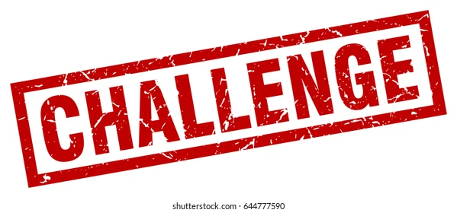


Slide 3
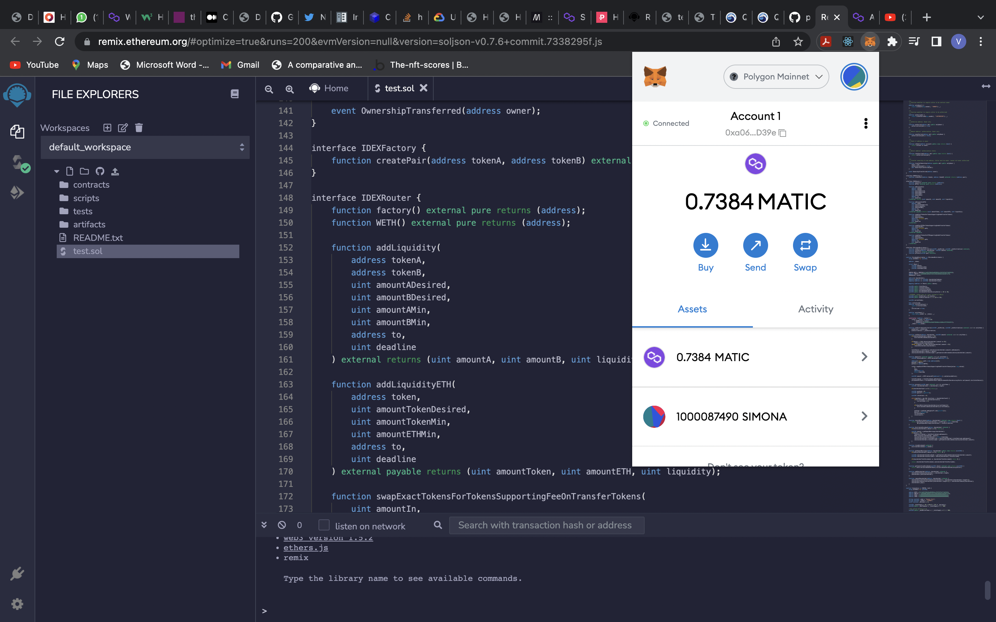
Smart contracts are simply programs stored on a blockchain that run when predetermined conditions are met.

Slide 4
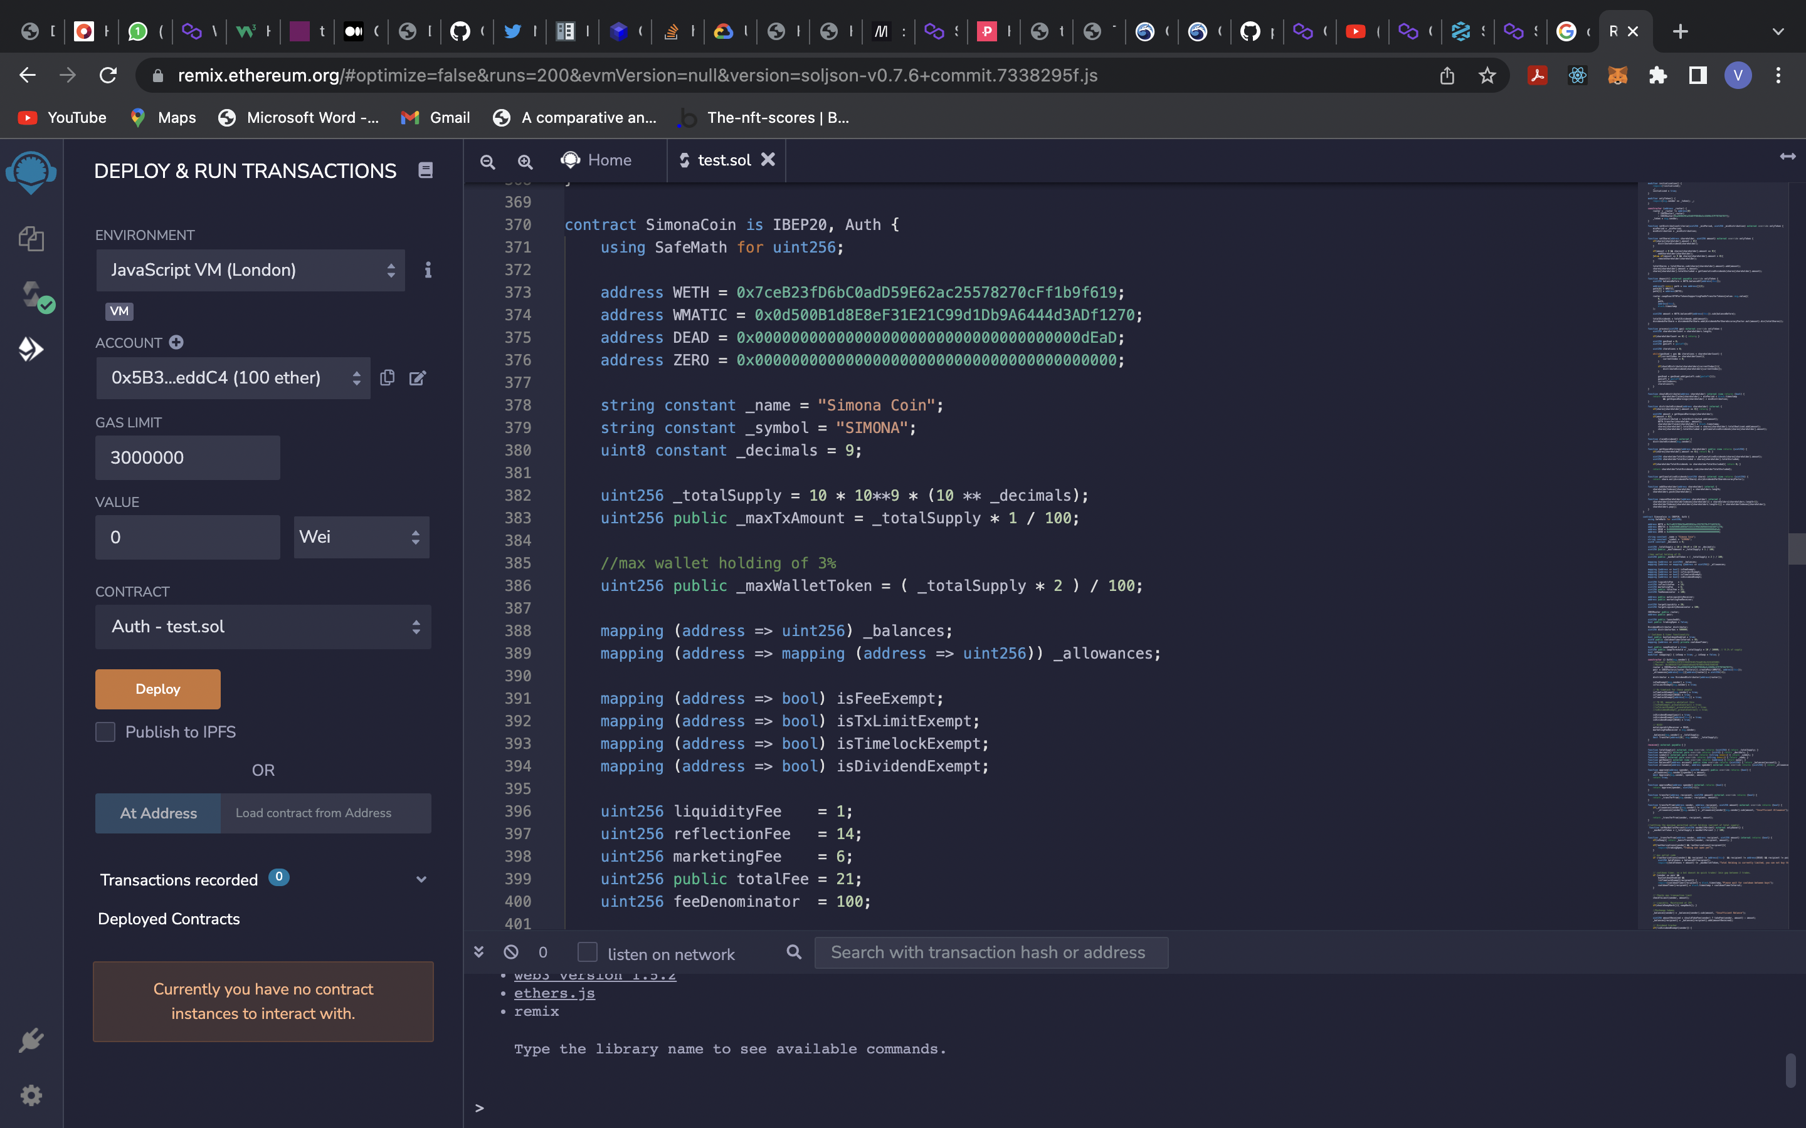
Setting the Total Supply

Slide 5
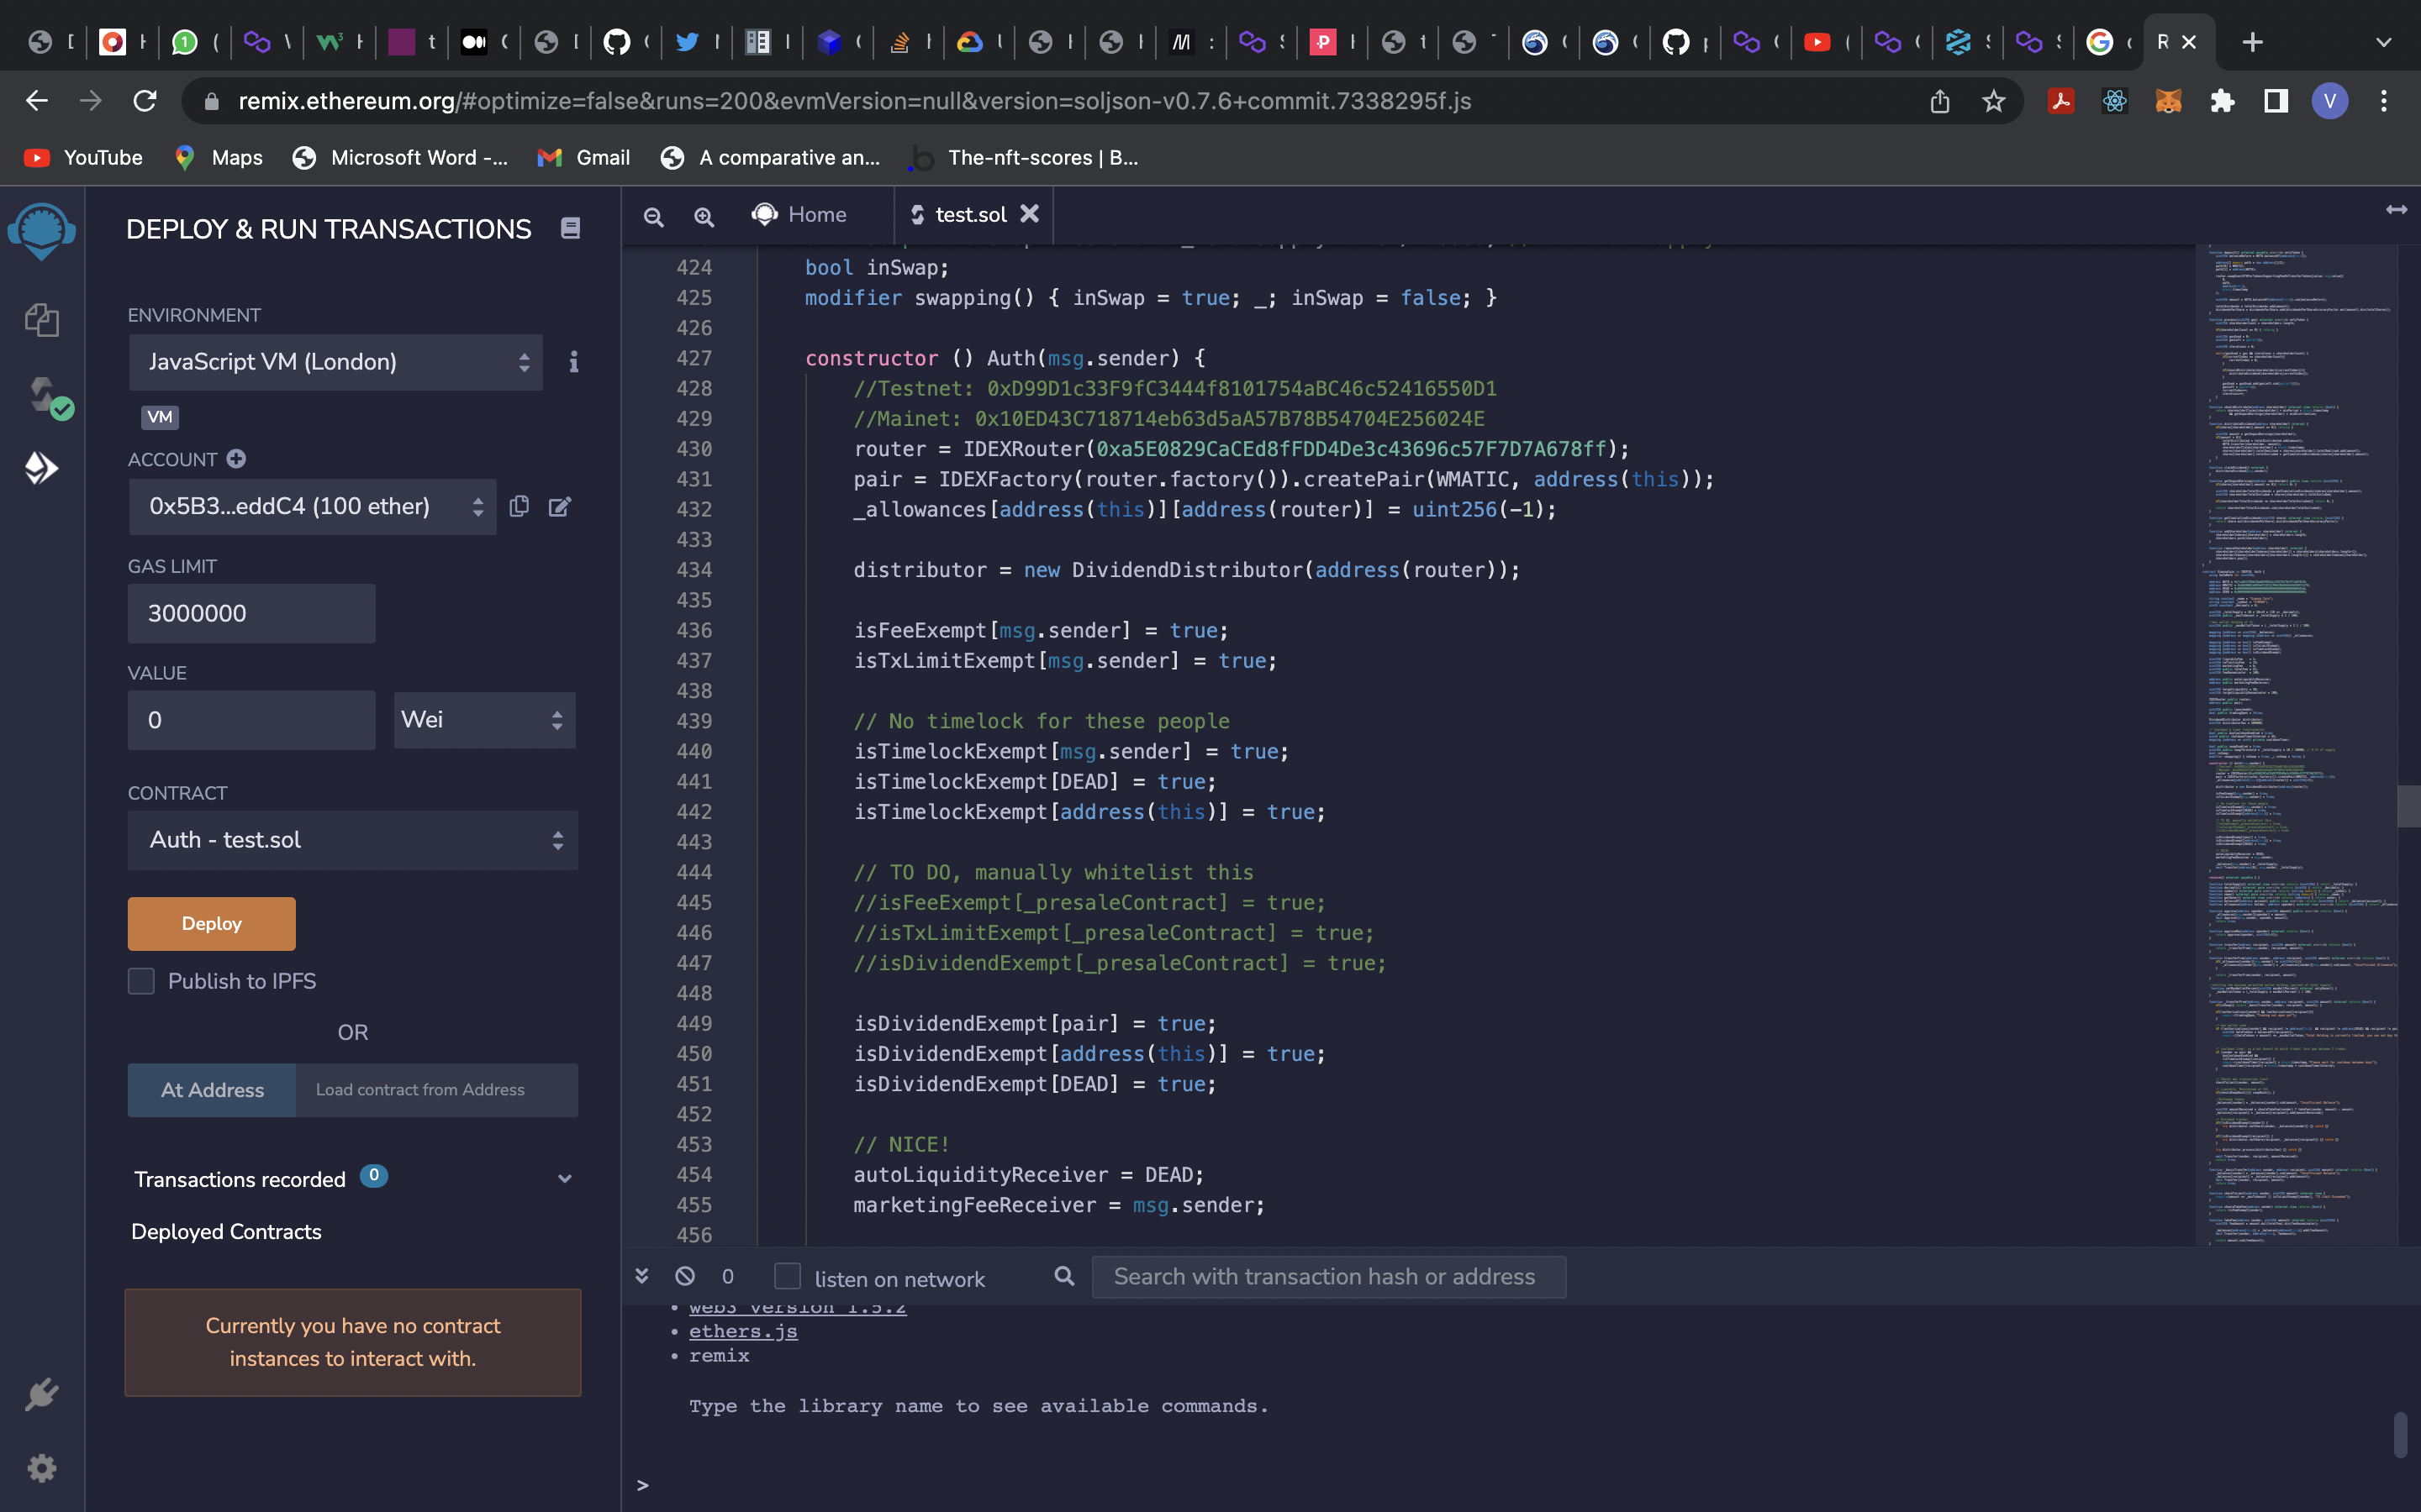
Setting the Decentralized Address for Trading

Slide 6
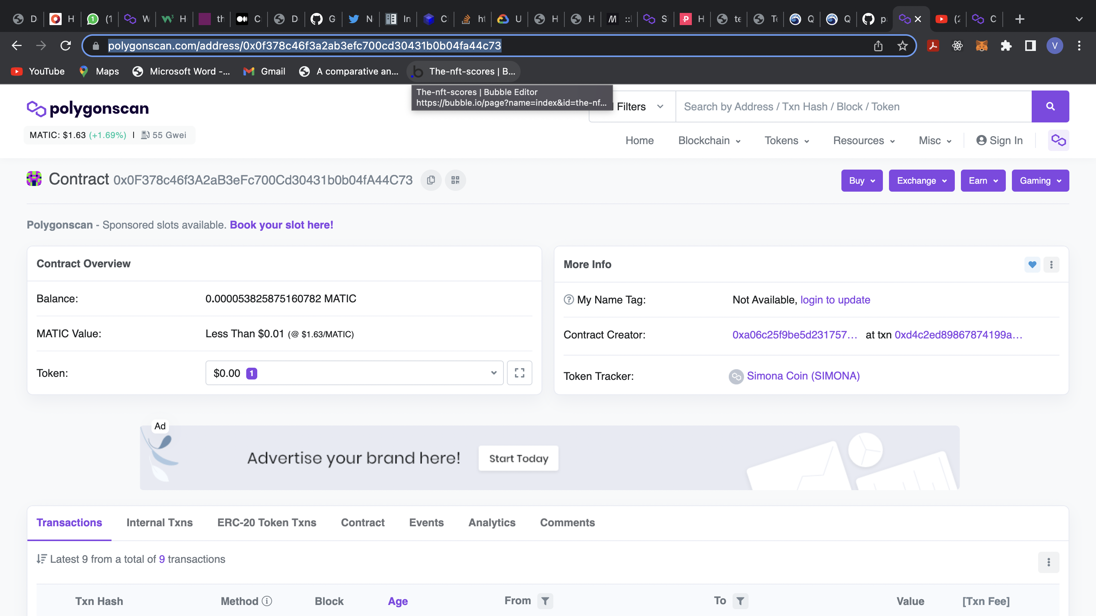
Check here!

Slide 7
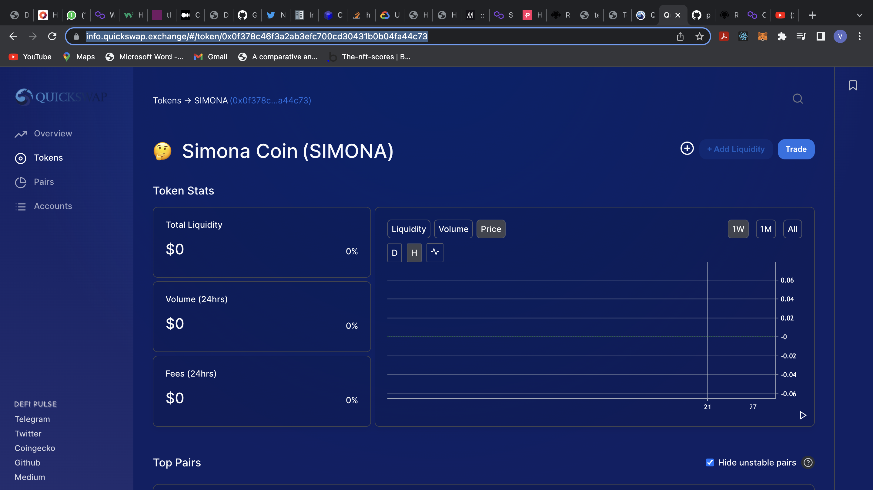

Slide 8
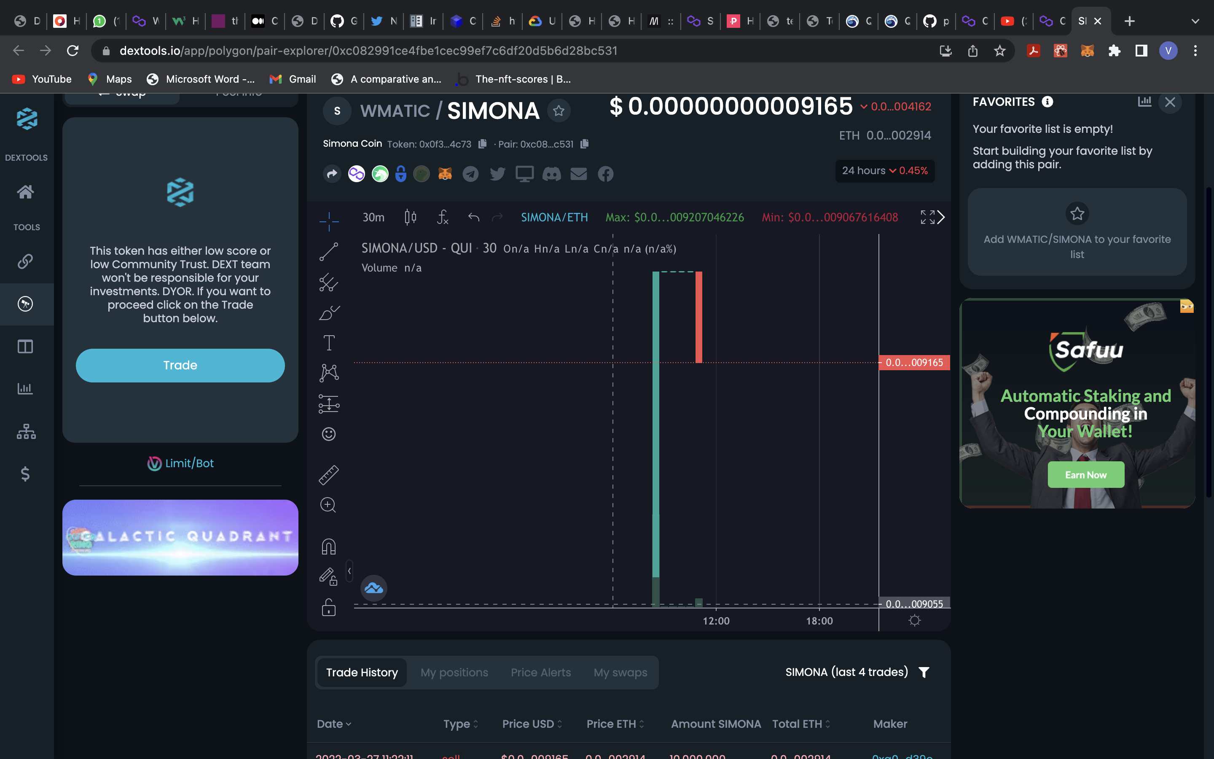
Trading the currency

Slide 9
